Slide 1
EXPORT DEFECT
TESTER: NGUYỄN HOÀNG VŨ - 51702215

Slide 2
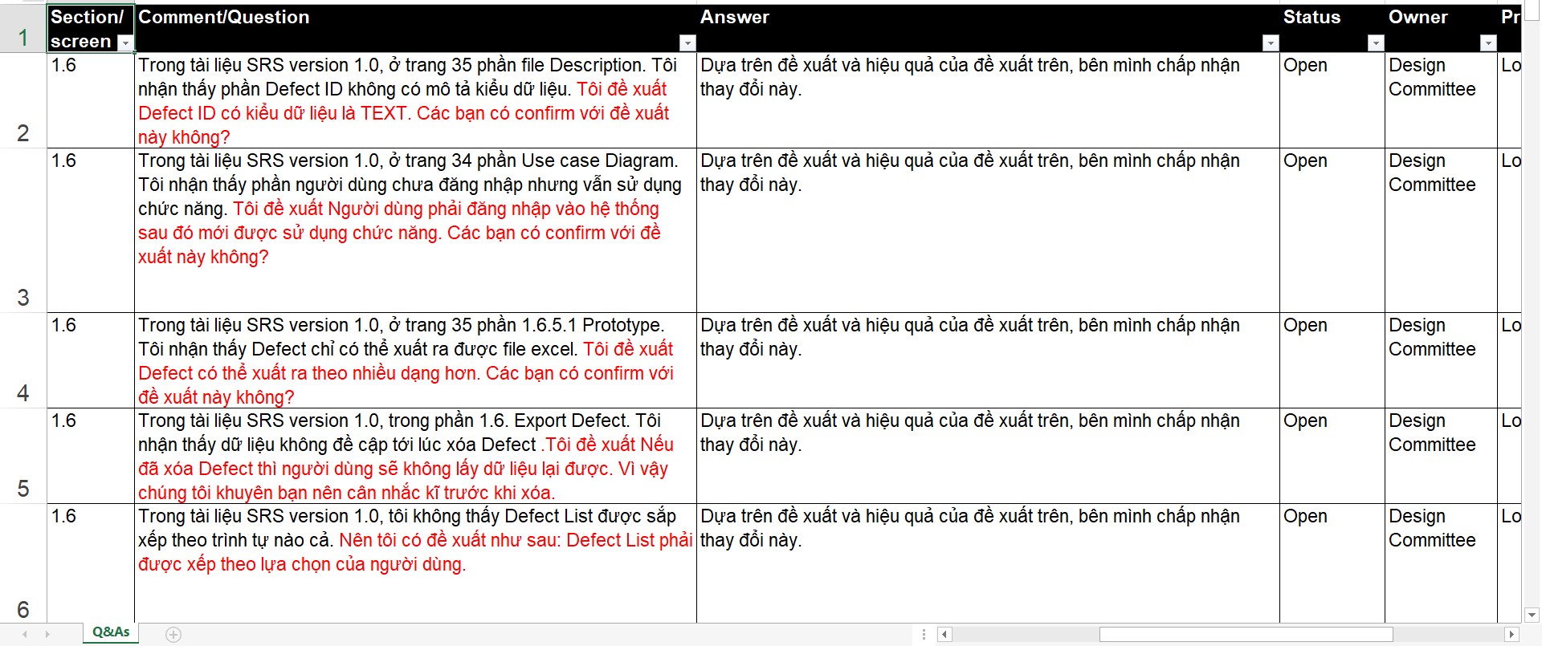

Slide 3
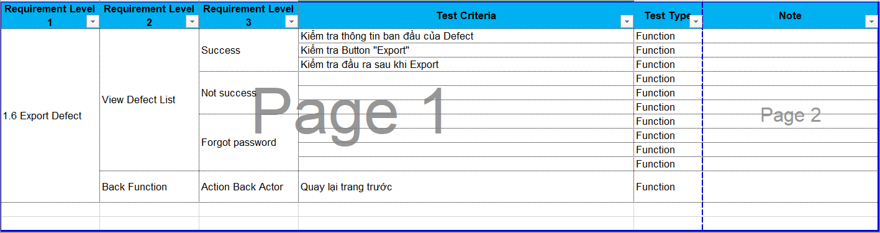

Slide 4
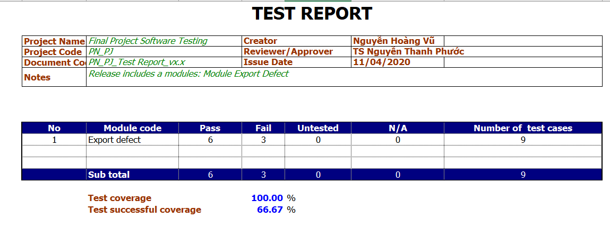

Slide 5
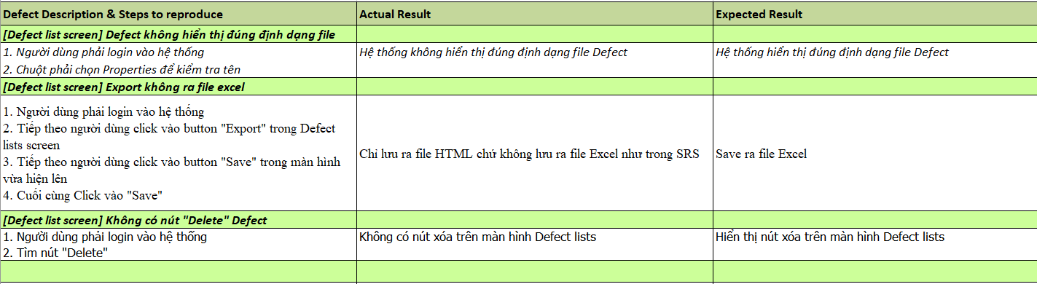

Slide 6
